Slide 1
Chapter 26
Estimation for Software Projects
These slides are designed to accompany Software Engineering: A Practitioner’s Approach, 7/e (McGraw-Hill 2009). Slides copyright 2009 by Roger Pressman.

Slide 2
Software Project Estimation
Estimation of resources, cost, and schedule for a software engineering effort requires
  experience
  access to good historical information (metrics)
  the courage to commit to quantitative predictions when qualitative information is all that exists
Estimation carries inherent risk and this risk leads to uncertainty
These slides are designed to accompany Software Engineering: A Practitioner’s Approach, 7/e (McGraw-Hill 2009). Slides copyright 2009 by Roger Pressman.

Slide 3
Write it Down!
Project Scope
Estimates
Risks
Schedule
Control strategy
Software
Project
Plan
These slides are designed to accompany Software Engineering: A Practitioner’s Approach, 7/e (McGraw-Hill 2009). Slides copyright 2009 by Roger Pressman.

Slide 4
To Understand Scope ...
Understand the customers needs
understand the business context
understand the project boundaries
understand the customer’s motivation
understand the likely paths for change
understand that ...
Even when you understand,
nothing is guaranteed!
These slides are designed to accompany Software Engineering: A Practitioner’s Approach, 7/e (McGraw-Hill 2009). Slides copyright 2009 by Roger Pressman.

Slide 5
What is Scope?
Software scope describes
  the functions and features that are to be delivered to end-users
  the data that are input and output
  the “content” that is presented to users as a consequence of using the software
  the performance, constraints, interfaces, and reliability that bound the system.
Scope is defined using one of two techniques:
    A narrative description of software scope is developed after communication with all stakeholders.
    A set of use-cases is developed by end-users.
These slides are designed to accompany Software Engineering: A Practitioner’s Approach, 7/e (McGraw-Hill 2009). Slides copyright 2009 by Roger Pressman.

Slide 6
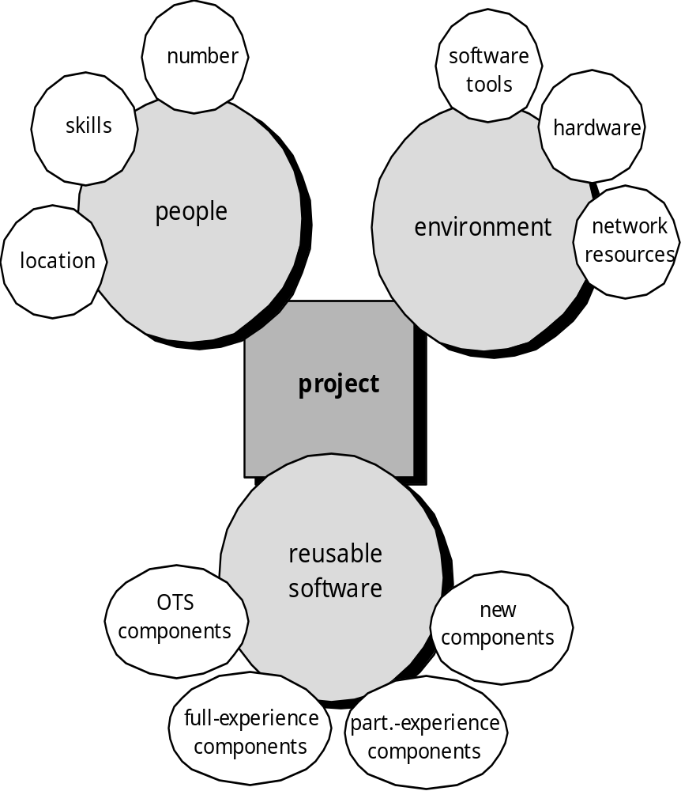
Resources
These slides are designed to accompany Software Engineering: A Practitioner’s Approach, 7/e (McGraw-Hill 2009). Slides copyright 2009 by Roger Pressman.

Slide 7

Project Estimation
Project scope must be understood
Elaboration (decomposition) is necessary
Historical metrics are very helpful
At least two different techniques should be used
Uncertainty is inherent in the process
These slides are designed to accompany Software Engineering: A Practitioner’s Approach, 7/e (McGraw-Hill 2009). Slides copyright 2009 by Roger Pressman.

Slide 8

Estimation Techniques
Past (similar) project experience
Conventional estimation techniques
  task breakdown and effort estimates
  size (e.g., FP) estimates
Empirical models
Automated tools
These slides are designed to accompany Software Engineering: A Practitioner’s Approach, 7/e (McGraw-Hill 2009). Slides copyright 2009 by Roger Pressman.

Slide 9
Estimation Accuracy
Predicated on …
  the degree to which the planner has properly estimated the size of the product to be built
  the ability to translate the size estimate into human effort, calendar time, and dollars (a function of the availability of reliable software metrics from past projects)
  the degree to which the project plan reflects the abilities of the software team
  the stability of product requirements and the environment that supports the software engineering effort.
These slides are designed to accompany Software Engineering: A Practitioner’s Approach, 7/e (McGraw-Hill 2009). Slides copyright 2009 by Roger Pressman.

Slide 10
Functional Decomposition
Statement
of
Scope
functional
decomposition
Perform a Grammatical “parse”
These slides are designed to accompany Software Engineering: A Practitioner’s Approach, 7/e (McGraw-Hill 2009). Slides copyright 2009 by Roger Pressman.

Slide 11
Conventional Methods:
LOC/FP Approach
compute LOC/FP using estimates of information domain values
use historical data to build estimates for the project
These slides are designed to accompany Software Engineering: A Practitioner’s Approach, 7/e (McGraw-Hill 2009). Slides copyright 2009 by Roger Pressman.

Slide 12
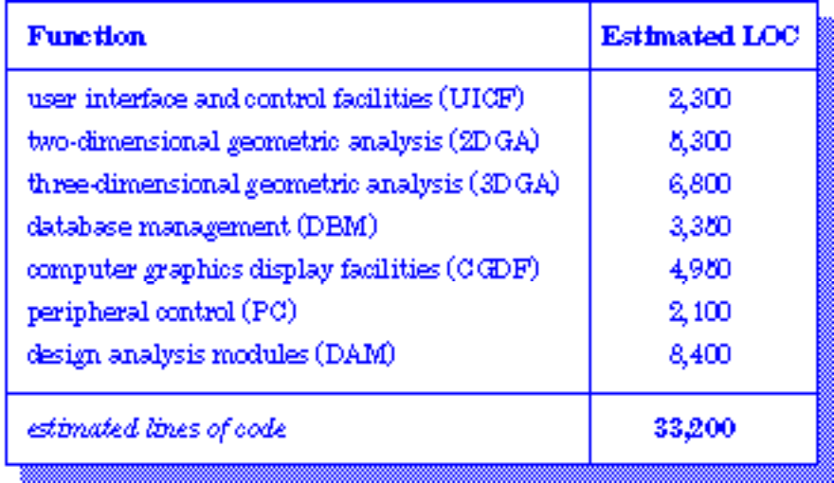
Example: LOC Approach
Average productivity for systems of this type = 620 LOC/pm.
Burdened labor rate =$8000 per month, the cost per line of code is approximately $13.
Based on the LOC estimate and the historical productivity data, the total estimated project cost is $431,000 and the estimated effort is 54 person-months.
These slides are designed to accompany Software Engineering: A Practitioner’s Approach, 7/e (McGraw-Hill 2009). Slides copyright 2009 by Roger Pressman.

Slide 13
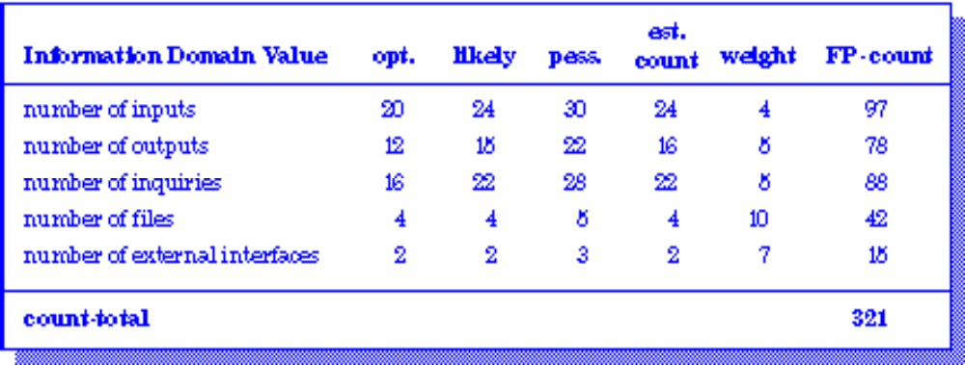
Example: FP Approach
The estimated number of FP is derived:
FP_{estimated} = count-total 3 [0.65 + 0.01 3 S (F_{i})]
FP_{estimated} = 375
organizational average productivity = 6.5 FP/pm.
burdened labor rate = $8000 per month, approximately $1230/FP.
Based on the FP estimate and the historical productivity data, total estimated project cost is $461,000 and estimated effort is 58 person-months.
These slides are designed to accompany Software Engineering: A Practitioner’s Approach, 7/e (McGraw-Hill 2009). Slides copyright 2009 by Roger Pressman.

Slide 14
Process-Based Estimation
Obtained from “process framework”
framework activities
application
functions
Effort required to accomplish
each framework activity for each application function
These slides are designed to accompany Software Engineering: A Practitioner’s Approach, 7/e (McGraw-Hill 2009). Slides copyright 2009 by Roger Pressman.

Slide 15
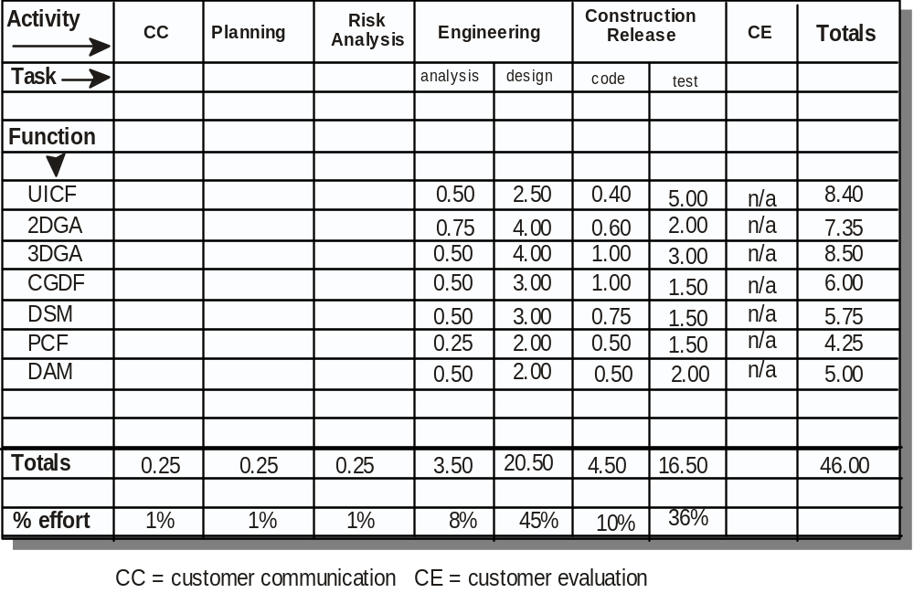
Process-Based Estimation Example
Based on an average burdened labor rate of $8,000 per month, the total estimated project cost is $368,000 and the estimated effort is 46 person-months.
These slides are designed to accompany Software Engineering: A Practitioner’s Approach, 7/e (McGraw-Hill 2009). Slides copyright 2009 by Roger Pressman.

Slide 16

Tool-Based Estimation
project characteristics
calibration factors
LOC/FP data
These slides are designed to accompany Software Engineering: A Practitioner’s Approach, 7/e (McGraw-Hill 2009). Slides copyright 2009 by Roger Pressman.

Slide 17
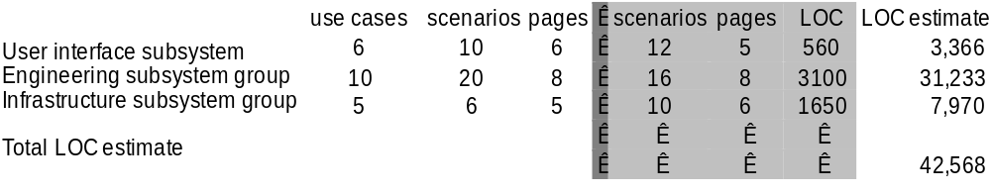
Estimation with Use-Cases
Using 620 LOC/pm as the average productivity for systems of this type and a burdened labor rate of $8000 per month, the cost per line of code is approximately $13. Based on the use-case estimate and the historical productivity data, the total estimated project cost is $552,000 and the estimated effort is 68 person-months.
These slides are designed to accompany Software Engineering: A Practitioner’s Approach, 7/e (McGraw-Hill 2009). Slides copyright 2009 by Roger Pressman.

Slide 18
Empirical Estimation Models
General form:
exponent
effort = tuning coefficient * size
usually derived
empirically
as person-months
derived
of effort required
usually LOC but
may also be
either a constant or
function point
a number derived based
on complexity of project
These slides are designed to accompany Software Engineering: A Practitioner’s Approach, 7/e (McGraw-Hill 2009). Slides copyright 2009 by Roger Pressman.

Slide 19
COCOMO-II
COCOMO II is actually a hierarchy of estimation models that address the following areas:
    Application composition model. Used during the early stages of software engineering, when prototyping of user interfaces, consideration of software and system interaction, assessment of performance, and evaluation of technology maturity are paramount.
    Early design stage model. Used once requirements have been stabilized and basic software architecture has been established.
    Post-architecture-stage model. Used during the construction of the software.
These slides are designed to accompany Software Engineering: A Practitioner’s Approach, 7/e (McGraw-Hill 2009). Slides copyright 2009 by Roger Pressman.

Slide 20
The Software Equation
A dynamic multivariable model
E = [LOC x B^{0.333}/P]³ x (1/t⁴)
where
E = effort in person-months or person-years
t = project duration in months or years
B = “special skills factor”
P = “productivity parameter”
These slides are designed to accompany Software Engineering: A Practitioner’s Approach, 7/e (McGraw-Hill 2009). Slides copyright 2009 by Roger Pressman.

